Slide 1


Modern Operating Systems
Fifth Edition
Chapter 3
Virtual Memory
Copyright © 2023, 2014, 2008 Pearson Education, Inc. All Rights Reserved
Notes:
If this PowerPoint presentation contains mathematical equations, you may need to check that your computer has the following installed:
1) Math Type Plugin
2) Math Player (free versions available)
3) NVDA Reader (free versions available)

Slide 2
Virtual Memory
There is a need to run programs that are too large to fit in memory
Solution adopted in the 1960s, split programs into little pieces, called overlays
Kept on the disk, swapped in and out of memory
Initially, only the overlay manager (O M) was loaded
The O M would then load overlay 0 and run it
When done, it would tell the O M to load overlay 1, etc.
Nowadays, we have a better solution: virtual memory
Often implemented using paging/segmenatation

Slide 3
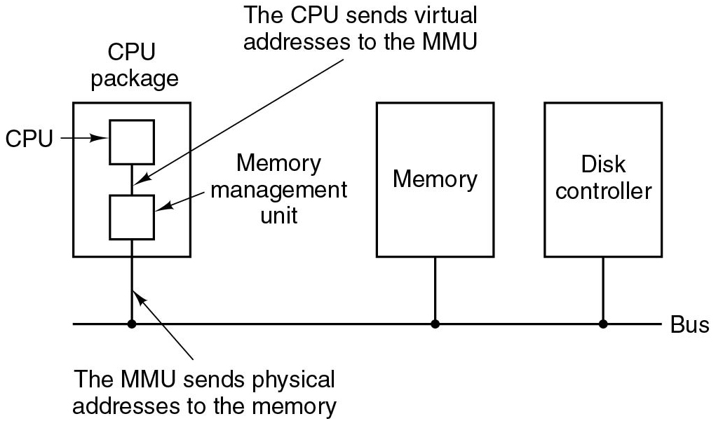
Virtual Memory
Problem: So far memory can only be given to processes in contiguous pieces
Solution:
Create for the process the illusion of a large (e.g., 48 bit) address space
This is known as the virtual address space
The (much more limited) R A M is known as physical memory
Translate virtual addresses (as used by the process) into physical addresses
Typically done in the M M U
Figure 3.8 The position and function of the M M U.
Notes:
Long Description:
The figure consists of a bus onto which three blocks are connected labeled C P U package, memory and disk controller. The C P U package block contains two blocks labeled C P U and Memory management unit and they are connected by a line labeled The C P U sends virtual addresses to the M M U. The blocks are connected to the bus through a line labeled The M M U sends physical addresses to the memory.

Slide 4
Segmentation
Memory-management scheme that supports user view of memory
A program is a collection of segments
A segment is a logical unit such as:
main program
procedure
function
method
object
local variables, global variables
common block
stack
symbol table
arrays

Slide 5
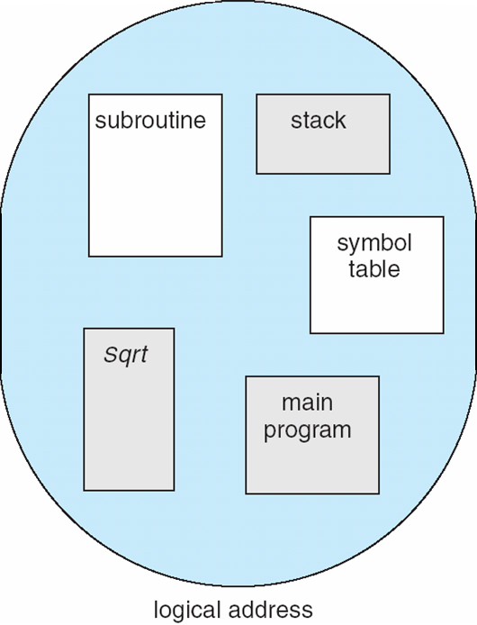
User’s View of a Program

Slide 6
Logical View of Segmentation
1
1
4
2
3
4
2
3
user space
physical memory space

Slide 7
Segmentation Architecture
Logical address consists of a two tuple:
<segment-number, offset>,
Segment table – maps two-dimensional physical addresses; each table entry has:
base – contains the starting physical address where the segments reside in memory
limit – specifies the length of the segment
Segment-table base register (STBR) points to the segment table’s location in memory
Segment-table length register (STLR) indicates number of segments used by a program;
segment number s is legal if s < STLR

Slide 8
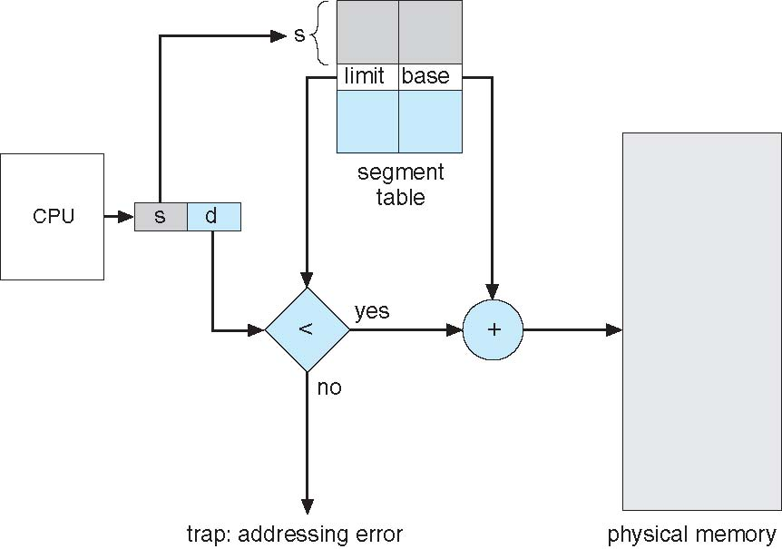
Segmentation Hardware

Slide 9
Paging
Physical address space of a process can be noncontiguous; process is allocated physical memory whenever the latter is available
Avoids external fragmentation
Avoids problem of varying sized memory chunks
Divide physical memory into fixed-sized blocks called frames
Size is power of 2, between 512 bytes and 16 Mbytes
Divide logical memory into blocks of same size called pages
Keep track of all free frames
To run a program of size N pages, need to find N free frames and load program
Set up a page table to translate logical to physical addresses
Backing store likewise split into pages
Still have Internal fragmentation

Slide 10
Address Translation Scheme
Address generated by CPU is divided into:
Page number (p) – used as an index into a page table which contains base address of each page in physical memory
Page offset (d) – combined with base address to define the physical memory address that is sent to the memory unit
For given logical address space 2^{m} and page size 2^{n}

Slide 11
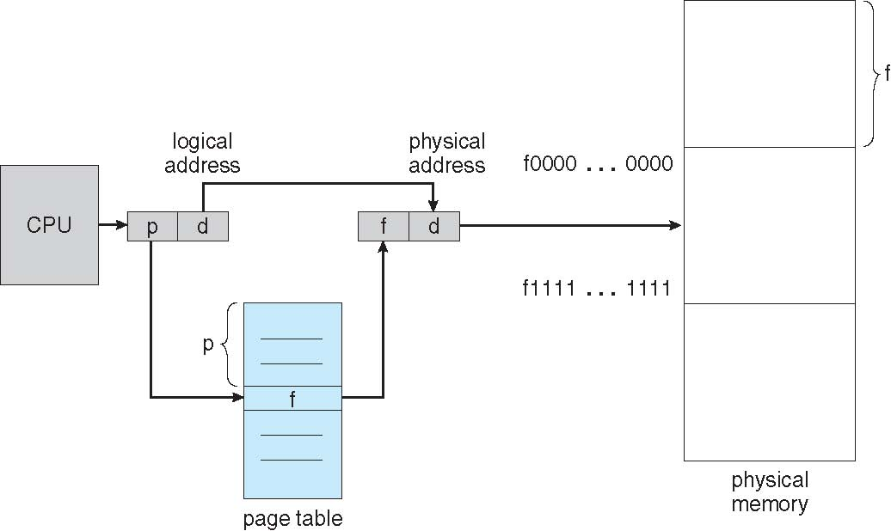
Paging Hardware

Slide 12

Paging Model of Logical and Physical Memory

Slide 13
Paging (Cont.)
Calculating internal fragmentation
Page size = 2,048 bytes
Process size = 72,766 bytes
35 pages + 1,086 bytes
Internal fragmentation of 2,048 - 1,086 = 962 bytes
Worst case fragmentation = 1 frame – 1 byte
On average fragmentation = 1 / 2 frame size
So small frame sizes desirable?
But each page table entry takes memory to track
Page sizes growing over time
Solaris supports two page sizes – 8 KB and 4 MB
Process view and physical memory now very different
By implementation process can only access its own memory

Slide 14
Implementation of Page Table
Page table is kept in main memory
Page-table base register (PTBR) points to the page table
Page-table length register (PTLR) indicates size of the page table
In this scheme every data/instruction access requires two memory accesses
One for the page table and one for the data / instruction
The two memory access problem can be solved by the use of a special fast-lookup hardware cache called associative memory or translation look-aside buffers (TLBs)

Slide 15
Implementation of Page Table (Cont.)
Some TLBs store address-space identifiers (ASIDs) in each TLB entry – uniquely identifies each process to provide address-space protection for that process
Otherwise need to flush at every context switch
TLBs typically small (64 to 1,024 entries)
On a TLB miss, value is loaded into the TLB for faster access next time
Replacement policies must be considered
Some entries can be wired down for permanent fast access

Slide 16
Associative Memory
Associative memory – parallel search
Address translation (p, d)
If p is in associative register, get frame # out
Otherwise get frame # from page table in memory

Slide 17

Paging Hardware With TLB

Slide 18
Effective Access Time
Associative Lookup = ε time unit
Can be < 10% of memory access time
Hit ratio = α
Hit ratio – percentage of times that a page number is found in the associative registers; ratio related to number of associative registers
Consider α = 80%, ε = 20ns for TLB search, 100ns for memory access
Effective Access Time (EAT)
EAT = (1 + ε) α + (2 + ε)(1 – α)
= 2 + ε – α
Consider α = 80%, ε = 20ns for TLB search, 100ns for memory access
EAT = 0.80 x 100 + 0.20 x 200 = 120ns
Consider more realistic hit ratio -> α = 99%, ε = 20ns for TLB search, 100ns for memory access
EAT = 0.99 x 100 + 0.01 x 200 = 101ns

Slide 19
Memory Protection
Memory protection implemented by associating protection bit with each frame to indicate if read-only or read-write access is allowed
Can also add more bits to indicate page execute-only, and so on
Valid-invalid bit attached to each entry in the page table:
“valid” indicates that the associated page is in the process’ logical address space, and is thus a legal page
“invalid” indicates that the page is not in the process’ logical address space
Or use page-table length register (PTLR)
Any violations result in a trap to the kernel

Slide 20

Valid (v) or Invalid (i) Bit In A Page Table

Slide 21
Structure of the Page Table
Memory structures for paging can get huge using straight-forward methods
Consider a 32-bit logical address space as on modern computers
Page size of 4 KB (2¹²)
Page table would have 1 million entries (2³² / 2¹²)
If each entry is 4 bytes -> 4 MB of physical address space / memory for page table alone
That amount of memory used to cost a lot
Don’t want to allocate that contiguously in main memory
Hierarchical Paging
Hashed Page Tables
Inverted Page Tables

Slide 22
Hierarchical Page Tables
Break up the logical address space into multiple page tables
A simple technique is a two-level page table
We then page the page table

Slide 23
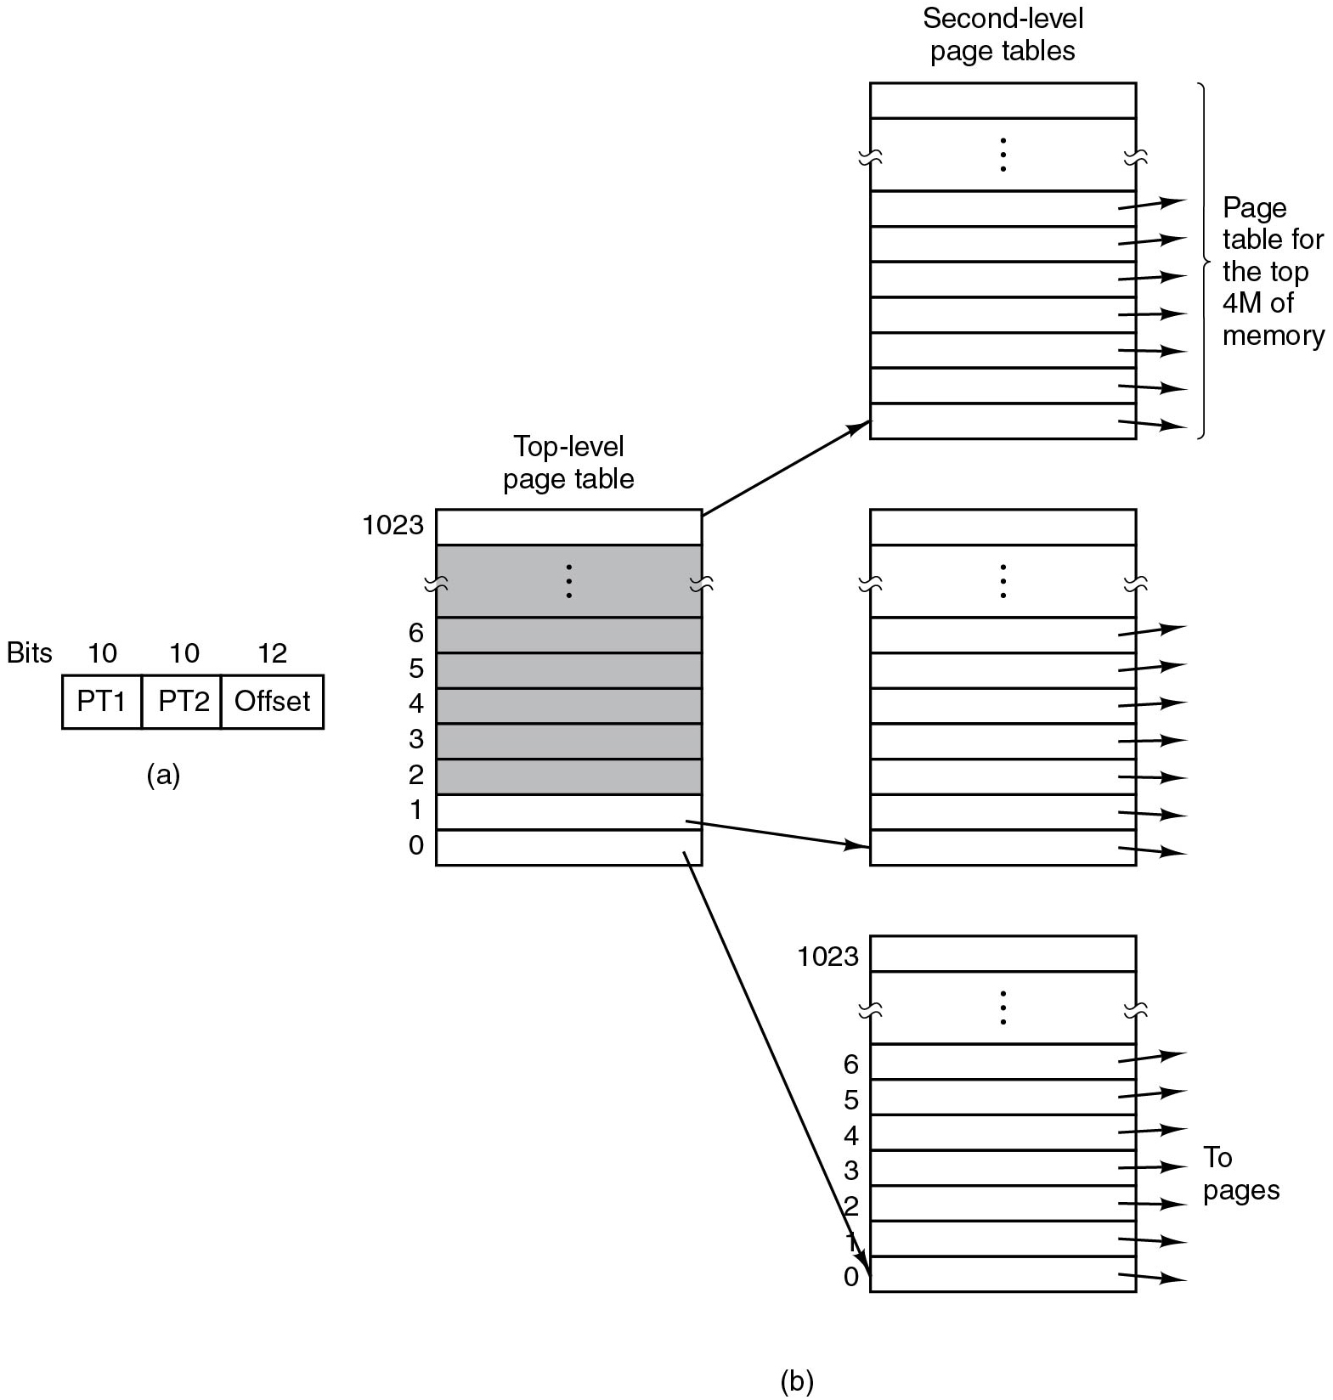
Two-level Page Tables (x86)
Page tables are “walked” by hardware M M U = Memory Management Unit
C R 3 register (special register to point to top of page table hierarchy)
Figure 3.13 (a) A 32-bit address with two page table fields. (b) Two-level page tables.
Notes:
32b: explain that there is no separate X flag, just R
Also: explain the meaning of the flags in P G D, P M D, etc. Refer to: https://wiki.osdev.org/Paging (excellent)
Long Description:
Part (a): A block consists of three rows. The rows are labeled P T 1, P T 2 and offset. The bits of the segments are given as 10, 10, 12.
Part (b): A block labeled top level page table has 1023 rows labeled from bottom to top as follows. 0, 1, 2, 3, 4, 5, 6, upto 1023. All the rows except the first, second and last are shaded.
This block is pointed to three other blocks labeled second level page tables which are placed one below the other. The blocks also consist of 1023 rows. Arrows are pointed from all the rows of these blocks. From the top block, the arrows are pointed to the Page table for the top 4 M of memory and from the top block, the arrows are pointed to the pages.

Slide 24
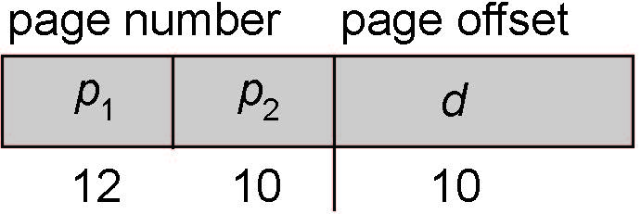
Two-Level Paging Example
A logical address (on 32-bit machine with 1K page size) is divided into:
a page number consisting of 22 bits
a page offset consisting of 10 bits
Since the page table is paged, the page number is further divided into:
a 12-bit page number
a 10-bit page offset
Thus, a logical address is as follows:
where p₁ is an index into the outer page table, and p₂ is the displacement within the page of the inner page table
Known as forward-mapped page table

Slide 25

Address-Translation Scheme

Slide 26
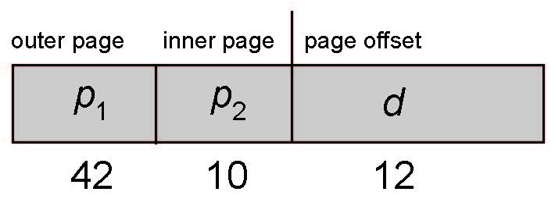
64-bit Logical Address Space
Even two-level paging scheme not sufficient
If page size is 4 KB (2¹²)
Then page table has 2⁵² entries
If two level scheme, inner page tables could be 2¹⁰ 4-byte entries
Address would look like
Outer page table has 2⁴² entries or 2⁴⁴ bytes
One solution is to add a 2nd outer page table
But in the following example the 2nd outer page table is still 2³⁴ bytes in size
And possibly 4 memory access to get to one physical memory location

Slide 27


Three-level Paging Scheme

Slide 28

Hashed Page Table

Slide 29
Inverted Page Table
Rather than each process having a page table and keeping track of all possible logical pages, track all physical pages
One entry for each real page of memory
Entry consists of the virtual address of the page stored in that real memory location, with information about the process that owns that page
Decreases memory needed to store each page table, but increases time needed to search the table when a page reference occurs
Use hash table to limit the search to one — or at most a few — page-table entries
TLB can accelerate access
But how to implement shared memory?
One mapping of a virtual address to the shared physical address

Slide 30
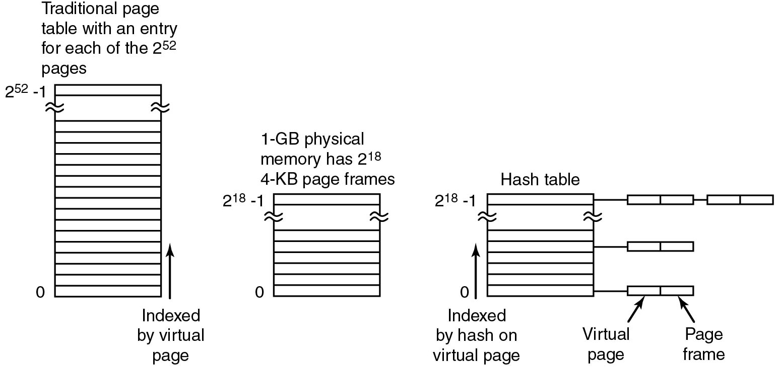
Inverted Page Tables (I A-64)
Figure 3.14 Comparison of a traditional page table with an inverted page table.
Notes:
Long Description:
The figure consists of three vertical blocks. The first block labeled traditional page table with an entry for each of the 2 raised to the 52 power pages consists of 2 raised to 52 power rows. An arrow labeled indexed by virtual page is pointed upward from bottom.
The second block labeled 1-G B physical memory has 2 raised to the eighteenth power. 4-K B page frames consist of 2 raised to the eighteenth power rows.
The third block labeled hash table consists of 2 raised to the eighteenth power rows. The top row is connected to two blocks containing two segments and connected sequentially. The first and fifth rows are also connected to blocks containing two segments. The first segment is labeled virtual page and the second segment is labeled page frame.

Slide 31
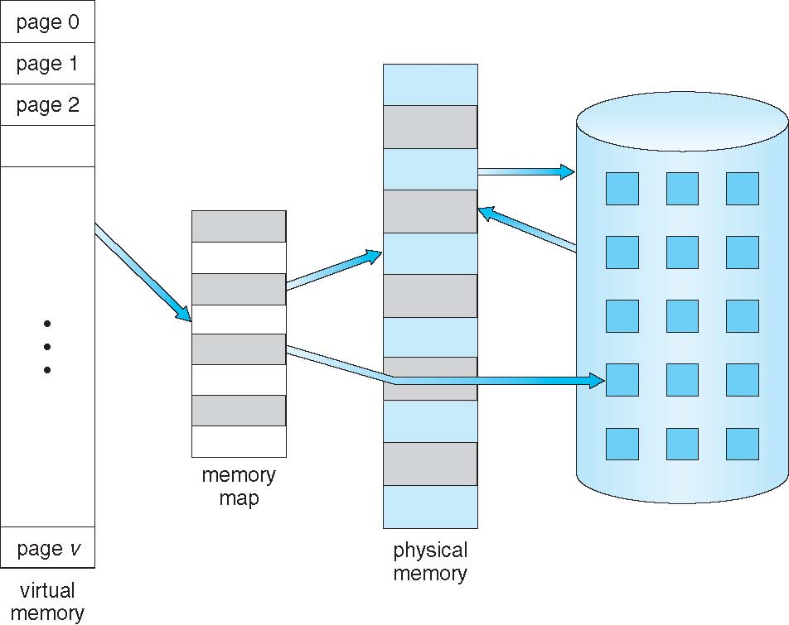
Virtual Memory That is Larger Than Physical Memory

Slide 32
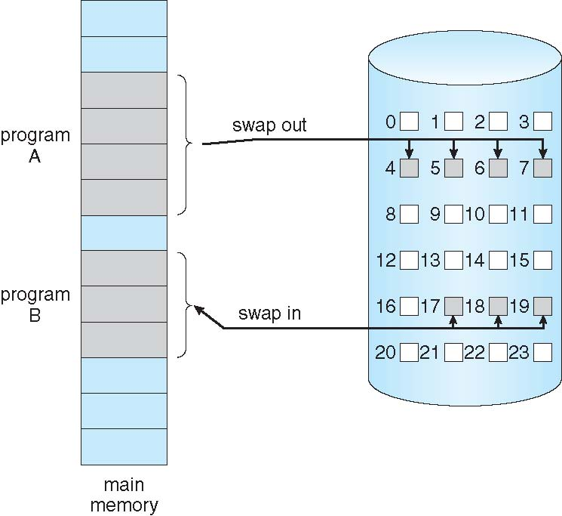
Demand Paging
Could bring entire process into memory at load time
Or bring a page into memory only when it is needed
Less I/O needed, no unnecessary I/O
Less memory needed
Faster response
More users
Similar to paging system with swapping (diagram on right)
Page is needed ⇒ reference to it
invalid reference ⇒ abort
not-in-memory ⇒ bring to memory
Lazy swapper – never swaps a page into memory unless page will be needed
Swapper that deals with pages is a pager

Slide 33
Basic Concepts
With swapping, pager guesses which pages will be used before swapping out again
Instead, pager brings in only those pages into memory
How to determine that set of pages?
Need new MMU functionality to implement demand paging
If pages needed are already memory resident
No difference from non demand-paging
If page needed and not memory resident
Need to detect and load the page into memory from storage
Without changing program behavior
Without programmer needing to change code

Slide 34
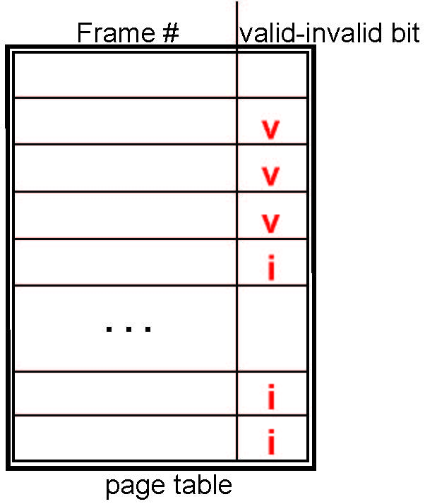
Valid-Invalid Bit
With each page table entry a valid–invalid bit is associated (v ⇒ in-memory – memory resident, i ⇒ not-in-memory)
Initially valid–invalid bit is set to i on all entries
Example of a page table snapshot:
During MMU address translation, if valid–invalid bit in page table entry is i ⇒ page fault

Slide 35
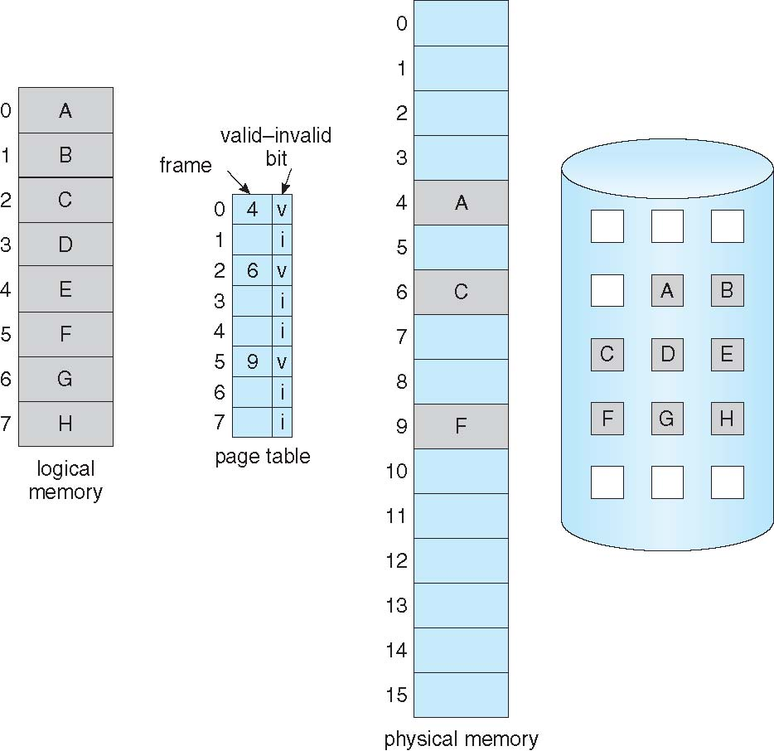
Page Table When Some Pages Are Not in Main Memory

Slide 36
Page Fault
If there is a reference to a page, first reference to that page will trap to operating system:
page fault
Operating system looks at another table to decide:
Invalid reference ⇒ abort
Just not in memory
Find free frame
Swap page into frame via scheduled disk operation
Reset tables to indicate page now in memory Set validation bit = v
Restart the instruction that caused the page fault

Slide 37

Steps in Handling a Page Fault

Slide 38
Aspects of Demand Paging
Extreme case – start process with no pages in memory
OS sets instruction pointer to first instruction of process, non-memory-resident -> page fault
And for every other process pages on first access
Pure demand paging
Actually, a given instruction could access multiple pages -> multiple page faults
Consider fetch and decode of instruction which adds 2 numbers from memory and stores result back to memory
Pain decreased because of locality of reference
Hardware support needed for demand paging
Page table with valid / invalid bit
Secondary memory (swap device with swap space)
Instruction restart

Slide 39
Performance of Demand Paging
Stages in Demand Paging (worse case)
Trap to the operating system
Save the user registers and process state
Determine that the interrupt was a page fault
Check that the page reference was legal and determine the location of the page on the disk
Issue a read from the disk to a free frame:
Wait in a queue for this device until the read request is serviced
Wait for the device seek and/or latency time
Begin the transfer of the page to a free frame
While waiting, allocate the CPU to some other user
Receive an interrupt from the disk I/O subsystem (I/O completed)
Save the registers and process state for the other user
Determine that the interrupt was from the disk
Correct the page table and other tables to show page is now in memory
Wait for the CPU to be allocated to this process again
Restore the user registers, process state, and new page table, and then resume the interrupted instruction

Slide 40
Demand Paging Optimizations
Swap space I/O faster than file system I/O even if on the same device
Swap allocated in larger chunks, less management needed than file system
Copy entire process image to swap space at process load time
Then page in and out of swap space
Used in older BSD Unix
Demand page in from program binary on disk, but discard rather than paging out when freeing frame
Used in Solaris and current BSD
Still need to write to swap space
Pages not associated with a file (like stack and heap) – anonymous memory
Pages modified in memory but not yet written back to the file system
Mobile systems
Typically don’t support swapping
Instead, demand page from file system and reclaim read-only pages (such as code)

Slide 41
Copy-on-Write
Copy-on-Write (COW) allows both parent and child processes to initially share the same pages in memory
If either process modifies a shared page, only then is the page copied
COW allows more efficient process creation as only modified pages are copied
In general, free pages are allocated from a pool of zero-fill-on-demand pages
Pool should always have free frames for fast demand page execution
Don’t want to have to free a frame as well as other processing on page fault
Why zero-out a page before allocating it?
vfork() variation on fork() system call has parent suspend and child using copy-on-write address space of parent
Designed to have child call exec()
Very efficient

Slide 42
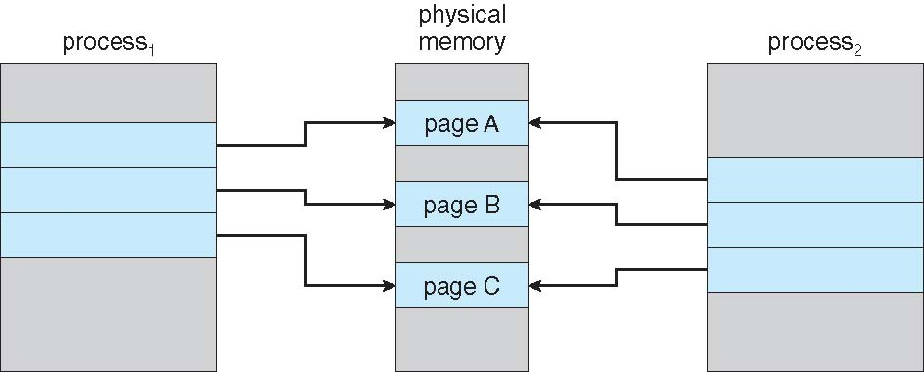
Before Process 1 Modifies Page C

Slide 43
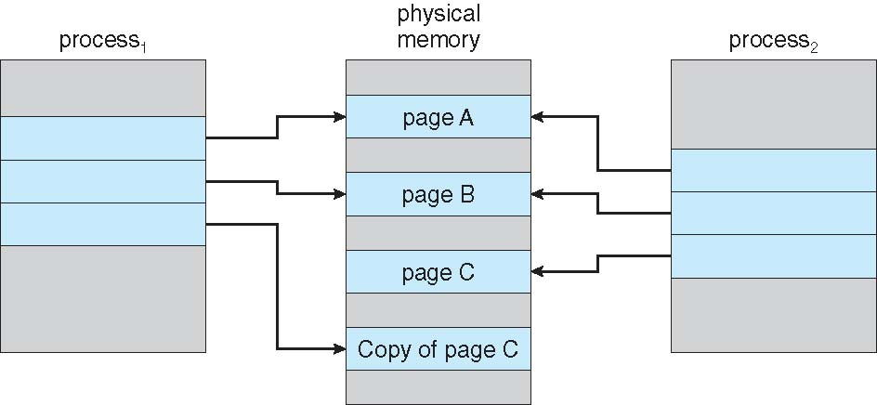
After Process 1 Modifies Page C

Slide 44
What Happens if There is no Free Frame?
Used up by process pages
Also in demand from the kernel, I/O buffers, etc
How much to allocate to each?
Page replacement – find some page in memory, but not really in use, page it out
Algorithm – terminate? swap out? replace the page?
Performance – want an algorithm which will result in minimum number of page faults
Same page may be brought into memory several times

Slide 45
Page Replacement
Computer might use more virtual memory than it has physical memory
Paging creates the illusion of unlimited memory available to user processes
When a logical page is not in memory (swapped out to a file/partition), the O S has to page it in on a page fault
Swapping out: direct or indirect reclaim
Another logical page has to be swapped out
which?

Slide 46
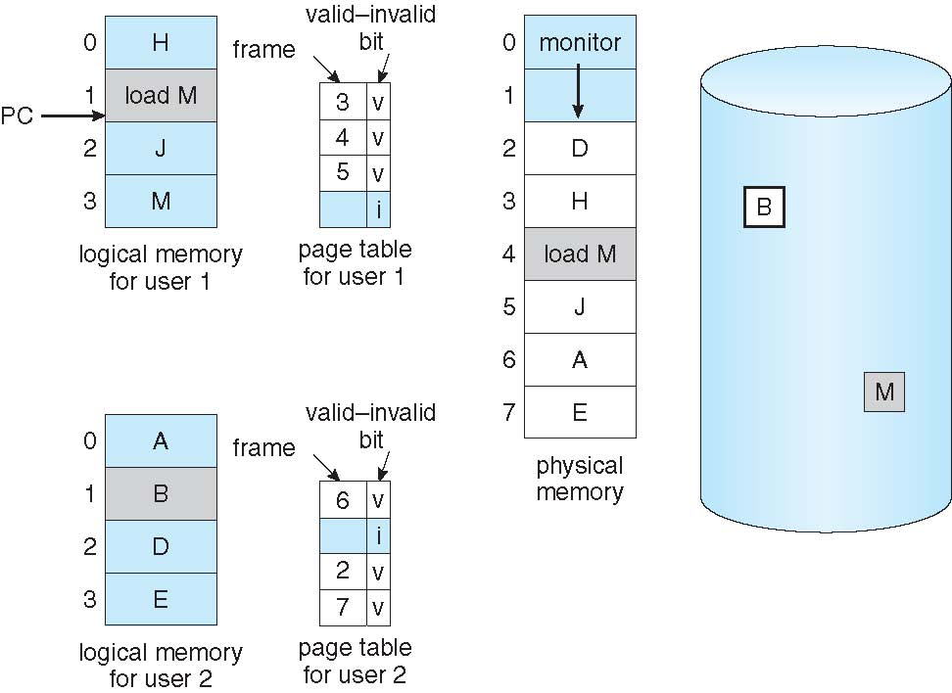
Need For Page Replacement

Slide 47
Basic Page Replacement
Find the location of the desired page on disk
Find a free frame: - If there is a free frame, use it - If there is no free frame, use a page replacement algorithm to select a victim frame - Write victim frame to disk if dirty
Bring the desired page into the (newly) free frame; update the page and frame tables
Continue the process by restarting the instruction that caused the trap
Note now potentially 2 page transfers for page fault – increasing EAT

Slide 48
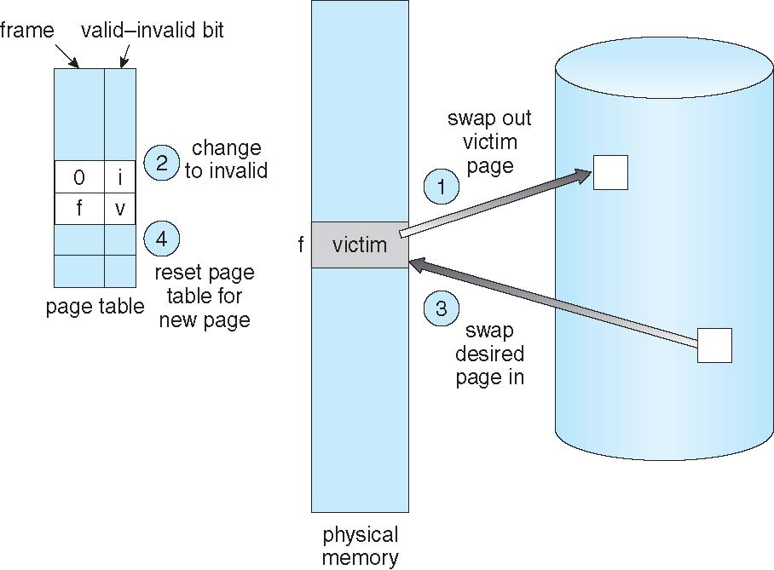
Page Replacement

Slide 49
Page and Frame Replacement Algorithms
Frame-allocation algorithm determines
How many frames to give each process
Which frames to replace
Page-replacement algorithm
Want lowest page-fault rate on both first access and re-access
Evaluate algorithm by running it on a particular string of memory references (reference string) and computing the number of page faults on that string
String is just page numbers, not full addresses
Repeated access to the same page does not cause a page fault
Results depend on number of frames available
In all our examples, the reference string of referenced page numbers is
7,0,1,2,0,3,0,4,2,3,0,3,0,3,2,1,2,0,1,7,0,1

Slide 50
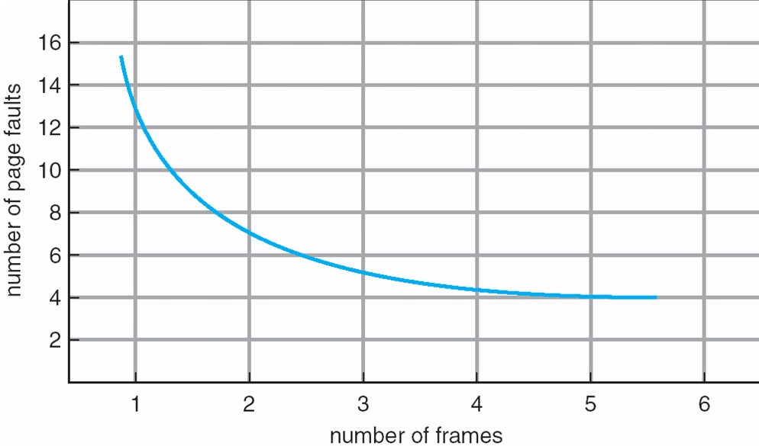
Graph of Page Faults Versus The Number of Frames

Slide 51
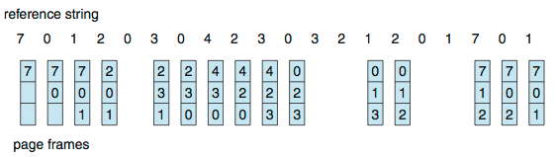
First-In-First-Out (FIFO) Algorithm
Reference string: 7,0,1,2,0,3,0,4,2,3,0,3,0,3,2,1,2,0,1,7,0,1
3 frames (3 pages can be in memory at a time per process)
Can vary by reference string: consider 1,2,3,4,1,2,5,1,2,3,4,5
Adding more frames can cause more page faults!
Belady’s Anomaly
How to track ages of pages?
Just use a FIFO queue
15 page faults

Slide 52
FIFO Illustrating Belady’s Anomaly

Slide 53
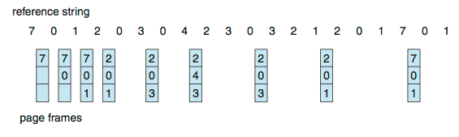
Optimal Algorithm
Replace page that will not be used for longest period of time
9 is optimal for the example
How do you know this?
Can’t read the future
Used for measuring how well your algorithm performs

Slide 54
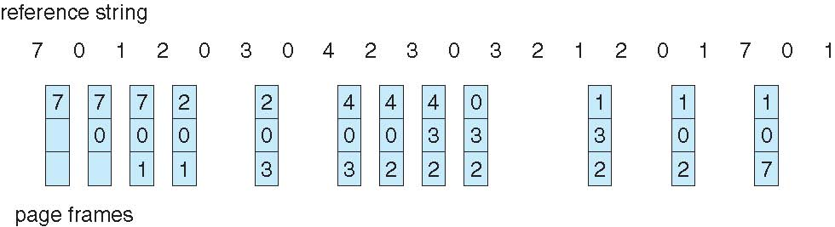
Least Recently Used (LRU) Algorithm
Use past knowledge rather than future
Replace page that has not been used in the most amount of time
Associate time of last use with each page
12 faults – better than FIFO but worse than OPT
Generally good algorithm and frequently used
But how to implement?

Slide 55
LRU Algorithm (Cont.)
Counter implementation
Every page entry has a counter; every time page is referenced through this entry, copy the clock into the counter
When a page needs to be changed, look at the counters to find smallest value
Search through table needed
Stack implementation
Keep a stack of page numbers in a double link form:
Page referenced:
move it to the top
requires 6 pointers to be changed
But each update more expensive
No search for replacement
LRU and OPT are cases of stack algorithms that don’t have Belady’s Anomaly

Slide 56
Use Of A Stack to Record Most Recent Page References

Slide 57
LRU Approximation Algorithms
LRU needs special hardware and still slow
Reference bit
With each page associate a bit, initially = 0
When page is referenced bit set to 1
Replace any with reference bit = 0 (if one exists)
We do not know the order, however
Second-chance algorithm
Generally FIFO, plus hardware-provided reference bit
Clock replacement
If page to be replaced has
Reference bit = 0 -> replace it
reference bit = 1 then:
set reference bit 0, leave page in memory
replace next page, subject to same rules

Slide 58
Second-Chance (clock) Page-Replacement Algorithm

Slide 59
Enhanced Second-Chance Algorithm
Improve algorithm by using reference bit and modify bit (if available) in concert
Take ordered pair (reference, modify)
(0, 0) neither recently used not modified – best page to replace
(0, 1) not recently used but modified – not quite as good, must write out before replacement
(1, 0) recently used but clean – probably will be used again soon
(1, 1) recently used and modified – probably will be used again soon and need to write out before replacement
When page replacement called for, use the clock scheme but use the four classes replace page in lowest non-empty class
Might need to search circular queue several times

Slide 60
Counting Algorithms
Keep a counter of the number of references that have been made to each page
Not common
Lease Frequently Used (LFU) Algorithm: replaces page with smallest count
Most Frequently Used (MFU) Algorithm: based on the argument that the page with the smallest count was probably just brought in and has yet to be used

Slide 61
Page-Buffering Algorithms
Keep a pool of free frames, always
Then frame available when needed, not found at fault time
Read page into free frame and select victim to evict and add to free pool
When convenient, evict victim
Possibly, keep list of modified pages
When backing store otherwise idle, write pages there and set to non-dirty
Possibly, keep free frame contents intact and note what is in them
If referenced again before reused, no need to load contents again from disk
Generally useful to reduce penalty if wrong victim frame selected

Slide 62
Applications and Page Replacement
All of these algorithms have OS guessing about future page access
Some applications have better knowledge – i.e. databases
Memory intensive applications can cause double buffering
OS keeps copy of page in memory as I/O buffer
Application keeps page in memory for its own work
Operating system can given direct access to the disk, getting out of the way of the applications
Raw disk mode
Bypasses buffering, locking, etc

Slide 63
Allocation of Frames
Each process needs minimum number of frames
Example: IBM 370 – 6 pages to handle SS MOVE instruction:
instruction is 6 bytes, might span 2 pages
2 pages to handle from
2 pages to handle to
Maximum of course is total frames in the system
Two major allocation schemes
fixed allocation
priority allocation
Many variations

Slide 64
Fixed Allocation
Equal allocation – For example, if there are 100 frames (after allocating frames for the OS) and 5 processes, give each process 20 frames
Keep some as free frame buffer pool
Proportional allocation – Allocate according to the size of process
Dynamic as degree of multiprogramming, process sizes change

Slide 65
Priority Allocation
Use a proportional allocation scheme using priorities rather than size
If process P_{i} generates a page fault,
select for replacement one of its frames
select for replacement a frame from a process with lower priority number

Slide 66
Global vs. Local Allocation
Global replacement – process selects a replacement frame from the set of all frames; one process can take a frame from another
But then process execution time can vary greatly
But greater throughput so more common
Local replacement – each process selects from only its own set of allocated frames
More consistent per-process performance
But possibly underutilized memory

Slide 67
Thrashing
If a process does not have “enough” pages, the page-fault rate is very high
Page fault to get page
Replace existing frame
But quickly need replaced frame back
This leads to:
Low CPU utilization
Operating system thinking that it needs to increase the degree of multiprogramming
Another process added to the system
Thrashing ≡ a process is busy swapping pages in and out

Slide 68
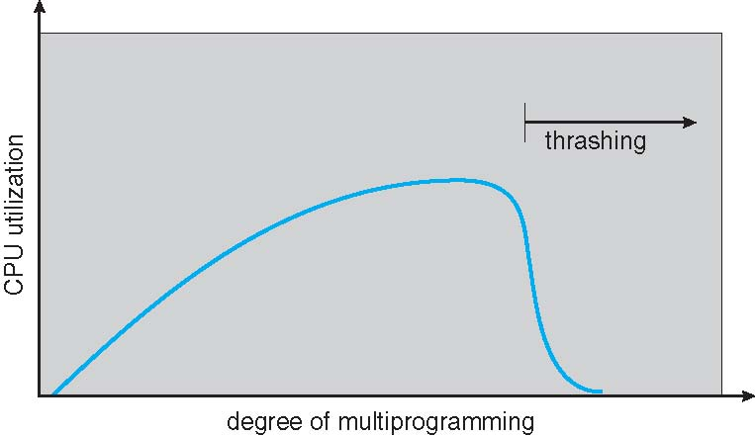
Thrashing (Cont.)

Slide 69
Demand Paging and Thrashing
Why does demand paging work? Locality model
Process migrates from one locality to another
Localities may overlap
Why does thrashing occur? Σ size of locality > total memory size
Limit effects by using local or priority page replacement

Slide 70
Locality In A Memory-Reference Pattern

Slide 71
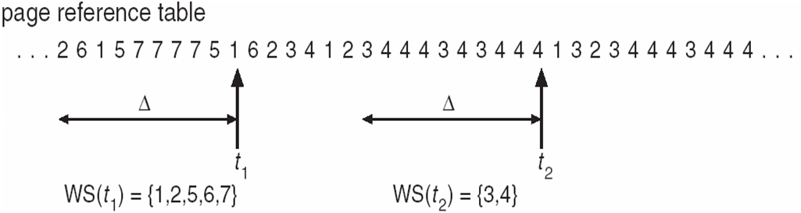
Working-Set Model
Δ ≡ working-set window ≡ a fixed number of page references Example: 10,000 instructions
WSS_{i} (working set of Process P_{i}) = total number of pages referenced in the most recent Δ (varies in time)
if Δ too small will not encompass entire locality
if Δ too large will encompass several localities
if Δ = ∞ ⇒ will encompass entire program
D = Σ WSS_{i} ≡ total demand frames
Approximation of locality
if D > m ⇒ Thrashing
Policy if D > m, then suspend or swap out one of the processes

Slide 72
Keeping Track of the Working Set
Approximate with interval timer + a reference bit
Example: Δ = 10,000
Timer interrupts after every 5000 time units
Keep in memory 2 bits for each page
Whenever a timer interrupts copy and sets the values of all reference bits to 0
If one of the bits in memory = 1 ⇒ page in working set
Why is this not completely accurate?
Improvement = 10 bits and interrupt every 1000 time units

Slide 73
Page-Fault Frequency
More direct approach than WSS
Establish “acceptable” page-fault frequency (PFF) rate and use local replacement policy
If actual rate too low, process loses frame
If actual rate too high, process gains frame

Slide 74
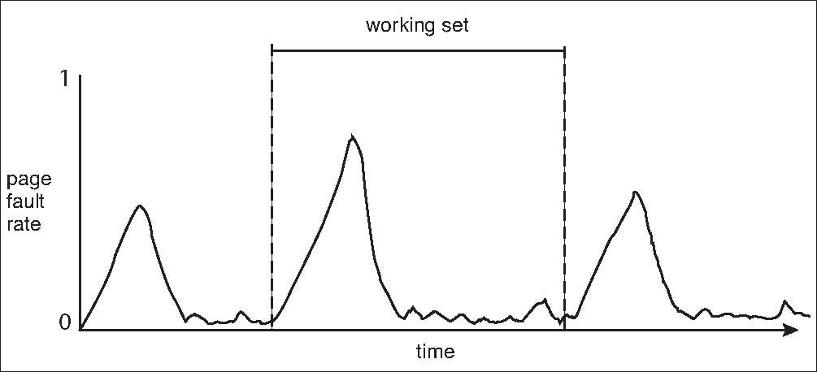
Working Sets and Page Fault Rates
Direct relationship between working set of a process and its page-fault rate
Working set changes over time
Peaks and valleys over time

Slide 75
Modern Operating Systems
Fifth Edition
Chapter 3 - End
Virtual Memory
Copyright © 2023, 2014, 2008 Pearson Education, Inc. All Rights Reserved
Notes:
If this PowerPoint presentation contains mathematical equations, you may need to check that your computer has the following installed:
1) Math Type Plugin
2) Math Player (free versions available)
3) NVDA Reader (free versions available)

